Slide 1

Load Forecasting Based on Clustering
Frank Zhang

Slide 2
Forecasting based on cluster center
The basic idea is to first group a number of commercial building based on the energy usage behavior as well as energy curve similarity
Then using Prophet to predict future loading on the cluster center and reconstruct the predicted loading on selected building based on historical deviation between cluster center and actual curve

Slide 3
Cluster Results
Clustering for the energy usage of each building is challenging since there are multiple information could be used for clustering. In this project, the following is done:
- compose a vector by concatenating normalized temperature, humidity and energy usage as a vector
- using normalized median value per month to compose a vector
- perform clustering for vector (temperature, humidiity, energy) in each building, and then using clustered center and inertia for each center to compose a new vector per building for clustering

Slide 4
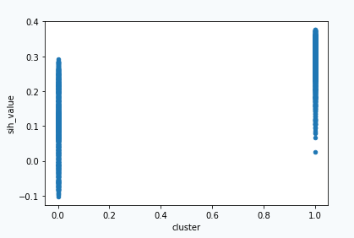
Cluster Results (Method 1)
Cluster | Sih_Value
0 | 0.110658
1 | 0.277771

Slide 5
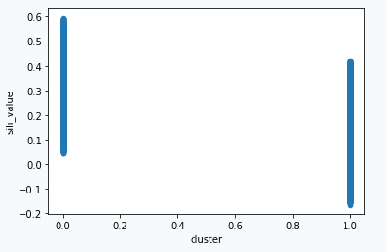
Cluster Results (Method 2)
Cluster | Sih_Value
0 | 0.425109
1 | 0.181460

Slide 6
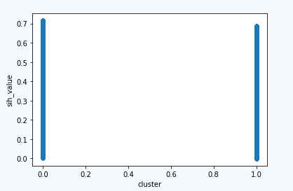
Cluster Results (Method 3)
Cluster | Sih_Value
0 | 0.572152
1 | 0.533320

Slide 7
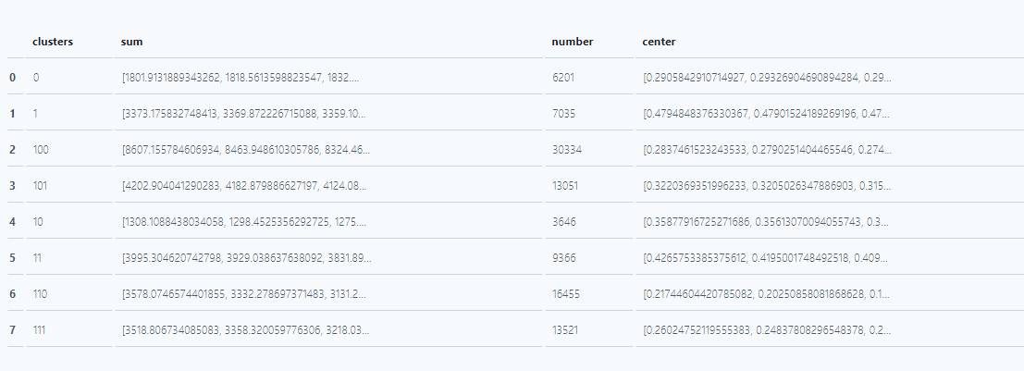
Final Cluster
By combining the cluster results, the following 8 clusters are created:

Slide 8
Forecasting using Prophet Package
By using prophet, load forecasting could be done quickly without specifying anything specifically.
However, to get the forecasted results within a reasonable range, a lot of tuning is required on prior_scale and fourier order. In the end a specific seasonality is added to improve results as well

Slide 9
Forecasted result comparison based on seasonality when forecasting on cluster center
 | With customized seasonality |  |  |  |  |  | Without customized seasonality
 | mse |  |  | mape |  |  | mse |  |  | mape
cluster | mean | min | max | mean | min | max | mean | min | max | mean | min | max
1 | 0.00288 | 0.001067 | 0.006315 | 0.263845 | 0.114724 | 0.492433 | 0.004301 | 0.001031 | 0.008195 | 0.323842 | 0.163952 | 0.51963
2 | 0.003619 | 0.001413 | 0.006084 | 0.260052 | 0.141786 | 0.431734 | 0.004727 | 0.002259 | 0.006673 | 0.299189 | 0.202764 | 0.461472
3 | 0.002514 | 0.00123 | 0.006969 | 0.21576 | 0.163676 | 0.271869 | 0.00284 | 0.00125 | 0.00792 | 0.231188 | 0.178972 | 0.278381
4 | 0.004194 | 0.003131 | 0.008508 | 0.247443 | 0.181499 | 0.303502 | 0.004397 | 0.002778 | 0.00897 | 0.249826 | 0.184409 | 0.315324
5 | 0.003093 | 0.002116 | 0.005528 | 0.146561 | 0.101082 | 0.228569 | 0.004354 | 0.002427 | 0.006086 | 0.175629 | 0.12732 | 0.226647
6 | 0.004797 | 0.002801 | 0.002801 | 0.170738 | 0.102737 | 0.277444 | 0.005785 | 0.003516 | 0.007954 | 0.19686 | 0.143266 | 0.269163
7 | 0.008779 | 0.006615 | 0.012286 | 0.222116 | 0.175455 | 0.27228 | 0.009492 | 0.007442 | 0.011083 | 0.243838 | 0.197751 | 0.281714
8 | 0.008637 | 0.00601 | 0.012478 | 0.236073 | 0.188879 | 0.311503 | 0.009248 | 0.007465 | 0.010781 | 0.249691 | 0.213145 | 0.288656
As shown above, with customized seasonality enabled, the results are better than the ones without customized seasonality

Slide 10
Forecast Load Function
In the end the following function is written:
def predict_load_seasonality (timestamp, building_ids, counties, energy, temperature, humidity, days_in_future, use_center=False, use_center_trigger_num=10, num_year=10)
# timestamp, building_ids, counties, energy, temperature and humidity are inputs could be used by this function
# days_in_future specifies the result time range
# use_center is a boolean to specify if cluster center should be used. If False, it will just use Temperature as added regressor, and forecast. If True, it will use cluster center to forecast with seasonality and hyperparameters tuned
# use_center_trigger_num is a parameter working with use_center. When use_center is True, this number will decide a threshold to actually use_center
# num_year is an integer to decide how much data of cluster center should be used for forecasting. The larger the number, the longer it will take

Slide 11
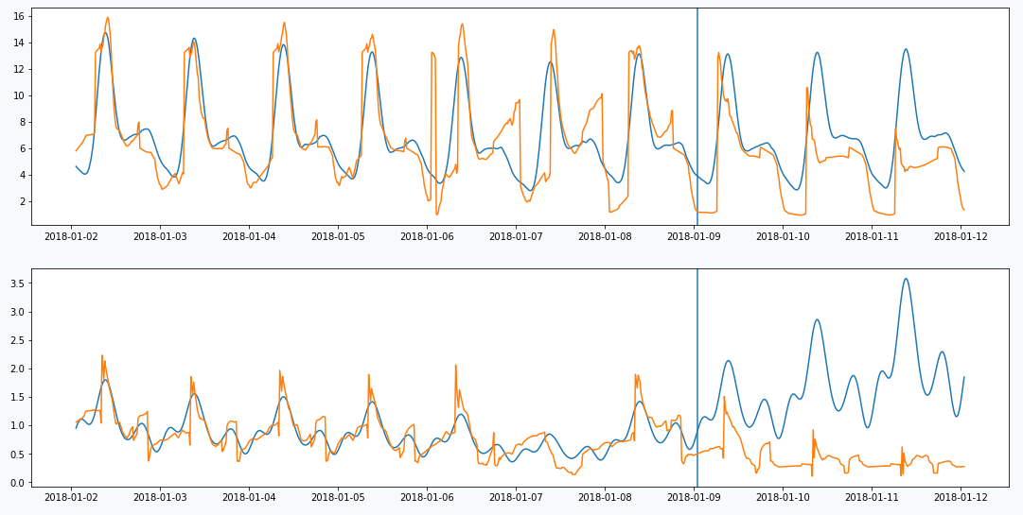
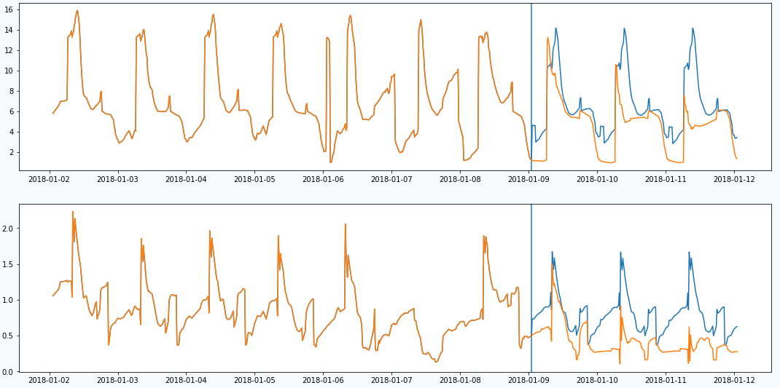
Forecasting result with and without using center
Without using center
With using center
Note that orange line is actual data, and blue line is forecasted result using model. After vertical blue line is the actual forecasted data

Slide 12
Forecasting results with and without using center (training data of 7 days to predict 3 days)
Number | MAPE without using center | MAPE using center
1 | 0.963399741 | 0.893522696
2 | 3.876000477 | 1.148945741
3 | 0.121973853 | 0.24431023
4 | 0.361102539 | 0.107038716
5 | 0.250953079 | 0.101054976
6 | 0.272065629 | 0.219583402
7 | 3.370912938 | 0.812902592
8 | 1.258024795 | 0.514853007
9 | 0.673269602 | 0.178147963
10 | 0.267096786 | 0.108277756
11 | 0.620925257 | 0.218324521
12 | 0.157158473 | 0.164319342
13 | 0.175358692 | 0.13529514
14 | 0.563030462 | 0.234263364
15 | 0.062811249 | 0.052564773
16 | 0.041993746 | 0.023342722
From the results on the left, see that when using cluster center, most of cases it has better results compared against the MAPE result without customized seasonality but with temperature as extra regressor

Slide 13
Forecasting results with and without using center (training data of 30 days to predict 3 days)
Number | MAPE without using center | MAPE using center
1 | 0.35588813 | 0.110174329
2 | 0.405572296 | 0.233250262
3 | 0.097665449 | 0.075755798
4 | 0.163891607 | 0.119540384
5 | 0.112412182 | 0.106377687
6 | 0.259275808 | 0.148512134
7 | 0.825085949 | 0.517321534
8 | 0.307992678 | 0.178264014
9 | 0.13902207 | 0.111142501
10 | 0.127311765 | 0.101596824
11 | 0.178919456 | 0.139908885
12 | 0.115031979 | 0.131625779
13 | 0.111270582 | 0.062616726
14 | 0.179048833 | 0.232403616
15 | 0.090972281 | 0.069405485
16 | 0.0687268 | 0.065545408
This is done with the training data to be a month of data.
In this case, the MAPE results are still better when using center data

Slide 14
Forecasting results with and without using center (training data of 180 days to predict 30 days)
Number | MAPE without using center | MAPE using center
1 | 0.376440872 | 0.145852673
2 | 0.320178515 | 0.313095505
3 | 0.093581957 | 0.076304125
4 | 0.158212225 | 0.157776203
5 | 0.115036777 | 0.10154829
6 | 0.180466025 | 0.152801094
7 | 1.059436235 | 1.364778828
8 | 0.435952378 | 0.560262096
9 | 0.228125312 | 0.146213417
10 | 0.170283 | 0.067686765
11 | 0.475614768 | 0.468708643
12 | 0.26538296 | 0.138304864
13 | 0.105929144 | 0.145593008
14 | 0.278867869 | 0.170572979
15 | 0.053806265 | 0.059303773
16 | 0.062170421 | 0.046713257
This is done with the training data to be 6 months of data.
In this case, the MAPE results are still better when using center data. However, more cases without using cluster center data seems to become more and more effective. This is probably due to the fact that deviation applied to each curve is simply using the average daily deviation of last week of training data.

Slide 15
Conclusion
The cluster center approach is effective compared against with direct prophet model with regressor on temperature.
However, the accuracy on the center curve is still possible to be further tuned
The time spent with using the center is much longer than simply using the Prophet curve since it has higher prior scale, higher fourier order as well as additional seasonality. But when forecasting with multiple curves are required, using center becomes more effective since less number of models are built in general, especially when the curves all comes from the same cluster.

Slide 16
Future work
To improve the accuracy of the forecast, introducing regressor and properly predict the deviation for each curve may be required.
When introducing the cluster, the cluster center may be changed when new curve information are added, there may be a need to dynamically adjust the cluster center when requested
The project currently focused on commercial building data but not residential building data. Further study on residential data may be carried out.

